Slide 1
Time value of money The Magic of Compounding

Slide 2
The Concept states that-
“ A rupee today is more valuable than a rupee a year hence.”

Slide 3
Reasons for TVM
In general investors prefer current consumption to future consumption.
As investment of one rupee today would grow to (1+r) a year hence .
Inflation – a continuous rise in Prices

Slide 4
Which would you prefer – Rs.10,000 today or Rs. 10,000 in 5 years?
Obviously, Rs. 10,000 today.
You already recognize that there is TIME VALUE TO MONEY!!

Slide 5
Compounding : It is a process of finding the Future value of present investment.
FV= PV * Compounding (FVF)(r,n)
Rate is called as Compound rate
Discounting : It is a process of finding the Present value of investment
PV= FV * Discounting(PVF)(r,n)
The interest rate used to discount cash flows is generally called the discount rate

Slide 6
Types of TVM Calculations
Present value of a lump sum
Future value of a lump sum
Present and future value of annuities
Present and future value of cash flow streams

Slide 7
Present Value of a Lump Sum
Present value calculations determine what the value of a cash flow received in the future would be worth today.

Slide 8
Example of PV of a Lump Sum
How much would Rs 100 received five years from now be worth today if the current interest rate is 10%?
Draw a timeline
PV = CF/ (1+r)^{n} PV = 100 / (1 + .10)⁵
PV = Rs 62.09
.
r = 10%
?
Rs 100
0
1
2
3
4
5

Slide 9
Future Value of a Lump Sum
Future value determines the amount that a sum of money invested today will grow to in a given period of time

Slide 10
Example of FV of a Lump Sum
How much money will you have in 5 years if you invest Rs 100 today at a 10% rate of return?
Draw a timeline
FV_{t} = CF₀ * (1+r)^{n} FV = Rs 100 * (1+.1)⁵
FV = Rs 161.05
i= 10%
Rs 100
?
0
1
2
3
4
5

Slide 11
Example
Calculate the compound value of Rs. 10,000 at the end of 3 year at 12 % rate of interest, when interest is calculated on
1. yearly basis
2. quarterly basis [ FV = CF0* (1+r/m)mxn]

Slide 12
Annuities
An annuity is a cash flow stream in which the cash flows are all equal and occur at regular intervals.

Slide 13
Example of PV of an Annuity
Assume that Sandy owns an investment that will pay her Rs 100O for 20 years. The current interest rate is 15%. What is the PV of this annuity? PVA=FV * FVAF (r,n)
1000
1000
1000
1000
0
1
2
3
………………………….
20
?
i = 15%

Slide 14
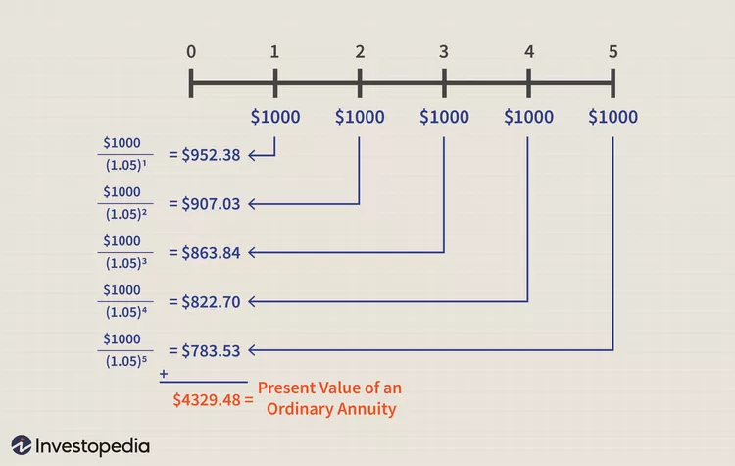

PVA $=\sum_{i=1}^{n}{}\frac{1}{\left(1+r\right)t}$

Slide 15

Cont…
What is the present value of an annuity that makes 5 annual payments of Rs. 200 each if the discount rate is 12%
present value of an annuity due
present value of an annuity due takes into account the fact that payments are made at the beginning rather than the end of each period.

Slide 16
Cont….
Suppose you are a beneficiary designated to immediately receive Rs.1000 each year for 10 years, earning an annual interest rate of 3%. What will be the value of stream of payments today?
Ans: Rs. 8,786.11.
An individual makes rental payments of Rs. 1,200 per month and wants to know the present value of their annual rentals over a 12-month period. The payments are made at the start of each month. The current interest rate is 8% per annum.
PV of the Investment = Rs. 13,886.90

Slide 17
FV of an Annuity
Assume that Sandy owns an investment that will pay her Rs 100 each year for 20 years. The current interest rate is 15%. What is the FV of this annuity?
100
100
100
1
………………………….
19
20
?
i = 15%

Slide 18
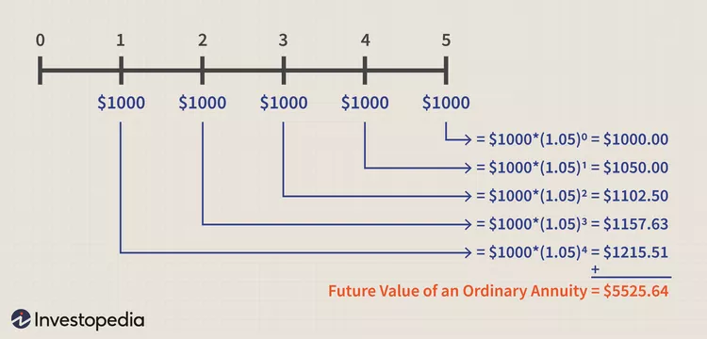
Cont…..
let's assume that you invest $1,000 every year for the next five years, at 5% interest. how much you would have at the end of the five-year period.

Slide 19
CONT….
where:
C=cash flow per period
r=interest rate
n=number of payments​

Slide 20
Cont….
Calculate the future value of an annuity from the data given below.
C = the cash flow per period, in this case, Rs.1000
r = the interest rate, in this case, 4%
n = the number of periods, 12

Slide 21
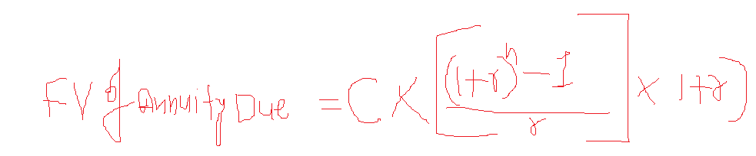
FV of an Annuity Due
A company wants to invest Rs. 3,500 every six months for four years to purchase a delivery truck. The investment will be compounded at an annual interest rate of 12% per annum. The initial investment will be made now, and thereafter, at the beginning of every six months. What is the future value of the cash flow payments?

Slide 22
APPLICATONS

Slide 23
example
Suppose you have decided to deposit Rs 30,000/- in a public Provident fund Account for 30 years. What will be the accumulated amount in your account at the end of 30 years if interest rate is 9%

